Slide 1

Retail Supply Chain & Warehousing Analytics

Slide 2


About Me
CHEERLA SANJANA
Background: B.Tech - IT ( Information Technology )
Why Data Science: To extract meaningful insights from raw data.
Experience: Fresher
LinkedIn:
GitHub:

Slide 3
Table of Contents
Project Overview
Business Scenario
Business Objectives
Dataset & Database Overview
ER Diagram & Database Structure
Analysis of the Objectives
Overall Key Findings
Business Recommendations
Conclusion
Q&A

Slide 4
Project Overview
This project focuses on analyzing retail supply chain and warehouse operations using MySQL. It explores purchase orders, suppliers, warehouses, staff, vehicles, and shipments to understand ordering patterns and shipment performance. The main goal is to extract meaningful business insights from data and support better operational decision-making. It also helps identify areas that require improvement in warehouse management and shipment handling. The analysis provides a clear understanding of how different parts of the supply chain work together. Overall, the project demonstrates how SQL can be used to solve real-world business problems through data analysis.

Slide 5
Business Scenario
NorthPeak Retail Supply Co. manages a network of regional warehouses that source products from external suppliers to meet retail store demand. The company’s operations involve purchase order management, warehouse activities, shipment coordination, and logistics resource utilization. To gain better visibility into these processes, the Operations team requires a structured analysis of purchase orders, warehouse performance, supplier activity, and shipment outcomes. This project uses MySQL to analyze the available operational data and identify meaningful insights that support informed business decisions.

Slide 6
Business Objectives
1
Analyze Purchase Orders - Understand order trends, product demand, and supplier activity.
2
Evaluate Warehouse Operations - Identify ordering patterns and compare warehouse performance.
3
Study Shipment Performance - Analyze delivery statuses and shipment durations.
4
Assess Resource Utilization - Understand how staff and vehicles are used in logistics
5
Identify Operational Issues - Discover repeated shipment attempts and areas needing improvement.

Slide 7
Dataset & Database Overview
Table | Rows | Columns | Purpose
warehouses | 30 | 7 | Warehouse location, type, region, capacity
suppliers | 150 | 6 | Supplier category and reliability rating
staff | 120 | 6 | Staff details, employment type, active status
vehicles | 90 | 7 | Vehicle type, payload, depot, service and active status
purchase_orders | 5,000 | 8 | Order date, warehouse, supplier, category, priority, quantity, cost
shipments | 5,800 | 10 | Shipment links, staff/vehicle, dates, status, attempts, distance, duration

Slide 8
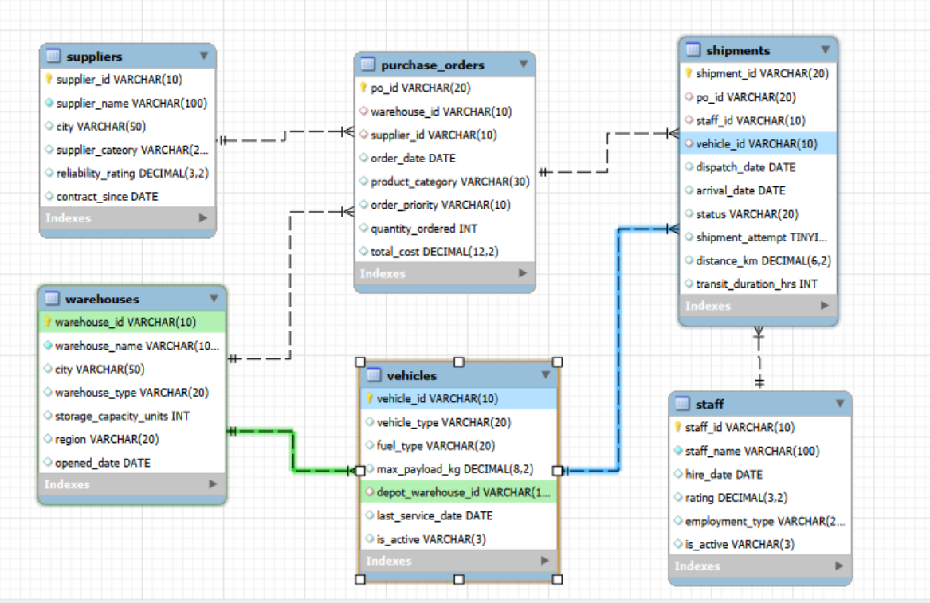
ER Diagram & Database Structure

Slide 9
ER Diagram & Database Structure
Tables and Relationships
The database consists of six interconnected tables: warehouses, suppliers, purchase_orders, shipments, staff, and vehicles. Each table stores specific information related to the retail supply chain operations. Primary keys uniquely identify records, while foreign keys establish relationships between the tables. The purchase_orders table connects warehouse and supplier details, and the shipments table links purchase orders with shipment information, including staff and vehicles. These relationships help integrate data across the database and support efficient analysis of supply chain activities.

Slide 10
Analysis of the Objectives
Objective 1: Purchase Order Demand Analysis
This objective focuses on understanding how purchase order demand is generated within the retail supply chain. Purchase orders represent the products requested by warehouses from suppliers to support retail operations. The analysis examines the number of purchase orders placed by different warehouses and suppliers to identify variations in purchasing activity. It also compares supplier categories, such as Manufacturers and Distributors, and studies orders based on priority levels and product categories. In addition, order volume over time and the cost associated with different product categories are analyzed to understand purchasing trends and demand patterns.
The analysis helps identify which warehouses, suppliers, and product categories contribute significantly to purchase order demand. It provides a better understanding of purchasing patterns and supports informed procurement planning.

Slide 11
Analysis of the Objectives
Objective 2: Warehouse Ordering Behaviour
This objective aims to understand how warehouses utilize the procurement process and how their ordering activities differ. The analysis compares warehouses based on the number of purchase orders raised and the total cost of those orders. It also examines ordering activity across different geographical regions and warehouse types, including Regional Warehouses, Local Warehouses, and Distribution Centers. By comparing these factors, the analysis explores differences in purchasing activity and helps understand how warehouse characteristics and locations relate to ordering behaviour.
The analysis provides insights into warehouse purchasing patterns, order volumes, and cost variations. It helps identify warehouses with higher ordering activity and supports better understanding of procurement operations.

Slide 12
Analysis of the Objectives
Objective 3: Shipment Performance Evaluation
This objective focuses on evaluating how purchase orders are fulfilled through shipments and understanding the outcomes of the delivery process. The analysis examines shipment statuses such as Delivered, Delayed, Damaged, and In-Transit to understand the different shipment outcomes. Transit duration is also analyzed to understand how long shipments take to move through the supply chain. Shipment performance is compared across suppliers, warehouses, order priorities, and different time periods. Since supplier information is stored in the purchase orders table, the analysis connects purchase orders with shipment records to evaluate fulfilment activity.
The analysis helps understand shipment outcomes, transit duration, and variations in shipment performance. It highlights delivery-related patterns and areas that may require further operational attention.

Slide 13
Analysis of the Objectives
Objective 4: Staff and Vehicle Performance Analysis
This objective examines how logistics resources are utilized in shipment operations. Staff members are involved in handling shipments, while vehicles are used to transport goods through the supply chain. The analysis compares the number of shipments handled by different staff members and examines their recorded performance ratings. It also explores shipment outcomes and transit duration across staff members. In addition, vehicle usage is compared across different vehicle types, and shipment performance is examined for individual vehicles to understand how the fleet is being utilized.
The analysis provides insights into staff workload, recorded ratings, and vehicle utilization. It helps understand the involvement of logistics resources in shipment operations and identify areas for further review.

Slide 14
Analysis of the Objectives
Objective 5: Shipment Problem Identification
This objective focuses on identifying shipment-related problems that may require additional operational effort. Some purchase orders may require multiple shipment attempts before the fulfilment process is completed. The analysis examines such records to understand the frequency of repeated attempts and the shipment statuses associated with them. It also compares shipment performance for orders with multiple attempts and investigates whether certain warehouses or suppliers experience more shipment-related issues. By examining these patterns, the project aims to identify recurring operational concerns within the shipment process.
The analysis helps identify repeated shipment attempts, shipment status patterns, and areas that may require further investigation. These insights can support efforts to improve shipment handling and operational efficiency.

Slide 15
Key Findings
A total of 5,000 purchase orders were analyzed and 5800 shipment records.
Grocery recorded the highest order count with 1,406 orders.
NorthPeak Kochi Distribution Warehouse recorded 399 orders.
3,686 shipments were marked as Delivered.
964 shipments were Damaged and 953 were Delayed.
In-Transit shipments accounted for 197 records.
The total recorded purchase order cost was 4.09 billion.

Slide 16
Business Recommendations
1
Improve procurement planning by monitoring purchase order demand across warehouses, suppliers, and product categories.
2
Review high-volume warehouse operations to support better resource and capacity planning.
3
Monitor delayed and damaged shipments to identify areas requiring operational attention.
4
Evaluate supplier fulfilment activity to support supplier performance reviews.
5
Analyze staff workload and vehicle utilization to improve logistics resource allocation.

Slide 17
Conclusion
A supply chain is more than just moving products—it’s about making the right decisions at every step. Through this project, we explored how purchase orders, warehouses, suppliers, shipments, staff, and vehicles work together. MySQL helped transform operational data into meaningful insights, revealing where planning can improve and where challenges need attention. Ultimately, this project shows how data can turn everyday supply chain activities into smarter, more efficient business decisions.

Slide 18
THANK YOU

